Slide 1
RTS/CTS-Induced Congestion in Ad Hoc Wireless LANs
Saikat Ray, Jeffrey B. Carruthers, and David Starobinski
Department of Electrical and Computer Engineering
Boston University

Slide 2
Outline
I. Introduction
II. Problems Introduced by RTS/CTS Mechanism
  RTS/CTS-induced Congestion
  The Blocking Problem
  The False Blocking Problem and its Propagation
  Pseudo-Deadlock
III. RTS Validation

Slide 3
Outline (continued)
IV. Simulation
  Simulation Models
  Results
V. Summary
VI. Observations
  Lack of mobility

Slide 4
MAC Protocols
Medium Access Control (MAC) protocols are critical to the performance of wireless networks
Though Carrier Sense Multiple Access (CSMA) is simple and scalable, it introduces the hidden and exposed receiver problems
MAC protocols evolving from CSMA attempt to resolve these problems while consequently introducing new problems

Slide 5
Keep in mind…
In wireless networks, only one node (transmitter) is allowed to transmit at any time within the range of a receiver
This implies that more than one transmitter can transmit within the range of each other as long as their receivers are not common and are not in range of each other

Slide 6

Hidden Receiver Problem
A neighboring node of a receiver is not able to detect transmission between a transmitter and the receiver
In this example, node C falsely assumes it can transmit to node D since node C cannot hear node A’s transmission to node B

Slide 7

Exposed Receiver Problem
A node hears an on-going transmission and falsely assumes it cannot transmit
In this example, node C falsely assumes it cannot transmit to node D since node C can hear node B’s transmission to A

Slide 8
RTS/CTS Mechanism
Multiple-Access with Collision Avoidance (MACA) is the first protocol to include RTS/CTS handshake mechanism used to combat the Hidden Receiver Problem
MACA for Wireless (MACAW) includes a MAC level acknowledgement (ACK)
IEEE 802.11 standard uses CSMA along with a variant of MACAW

Slide 9
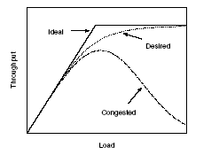
Problems Introduced by RTS/CTS
As the network load increases after a certain point, the throughput decreases to zero due to the increasing number of nodes that are unable to transmit a packet

Slide 10
RTS/CTS-induced Congestion
RTS/CTS-induced congestion is different from network-level congestion
Network-level congestion such as that which occurs in the TCP context is due to buffer overflow while RTS/CTS-induced congestion is related only to the MAC layer
It is desired to significantly reduce RTS/CTS-induced congestion to maximize throughput for high network loads

Slide 11
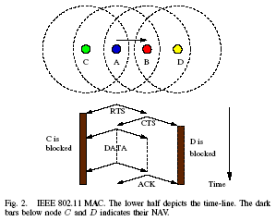
RTS/CTS Mechanism in IEEE 802.11
The deferral periods are managed by the Network Allocation Vector (NAV)

Slide 12
The Blocking Problem
A node is said to be blocked if it is prohibited from transmitting at a given instant
Neighbors of a blocked node are unaware of the fact that this node is blocked
Therefore, such a neighbor that intends to initiate data transmission will send in vain RTS packets without a response and will be forced to backoff
This is described as the blocking problem

Slide 13
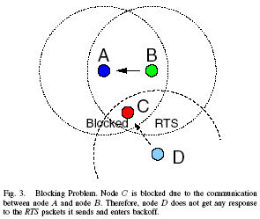
The Blocking Problem

Slide 14
The False Blocking Problem and Its Propagation
An RTS packet destined to a blocked node forces every other node that receives the RTS to inhibit transmission though no DATA transmission will take place
This is called the false blocking problem
Not all nodes are falsely blocked, however, the RTS/CTS mechanism causes propagation of false blocking due to the reception of any RTS packet, even those that do not lead to DATA transmission

Slide 15
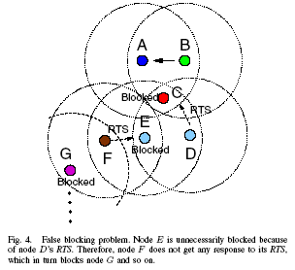
The False Blocking Problem

Slide 16
Pseudo-Deadlock
The propagation of the false blocking problem throughout a network can cause a potential deadlock if propagated in a circular path

Slide 17
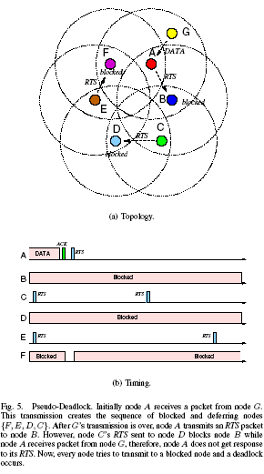
Pseudo-Deadlock

Slide 18
RTS Validation
An attempt to prevent false blocking
Upon overhearing an RTS packet, a node that uses RTS Validation defers for RTS_Defer_Time until the corresponding DATA transmission is expected to begin
After RTS_Defer_Time, the node accesses the channel for next Clear-Channel Assessment Time (CCA_Time) while continuing to defer
After the node determines a busy channel, the node will defers normally according to the Requested_Defer_Time required by RTS, otherwise the node will no longer defer

Slide 19
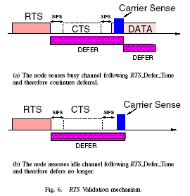
RTS Validation Mechanism

Slide 20
RTS Validation
The likelihood of propagation of false blocking is reduced since the RTS_Defer_Time and CCA_Time together are smaller than the Requested_Defer_Time
RTS Validation is backward-compatible in that nodes that use RTS validation can communicate with nodes that do not use RTS Validation

Slide 21
Previous Work to Solve False Blocking
In MACAW, another packet called DATA_Send (DS) is sent in response to CTS right before DATA transmission
Another paper proposes the use of Negative CTS (NCTS)
Though these two approaches perform similarly to RTS Validation, they lack the backward-compatibility advantage of RTS Validation

Slide 22
Simulation
The authors implemented the RTS Validation scheme using an IEEE 802.11 MATLAB based simulator called SimEleven (available at http://netlab1.bu.edu/~saikat)
SimEleven simulates a static two-dimensional network

Slide 23
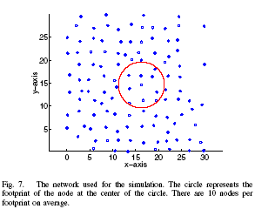
Simulation Models

Slide 24
Simulation Models
Around each node, a circular region, called the footprint, exists which defines the transmission range of the node
2300 byte size packets are transmitted at 1-Mbps according to Poisson arrival processes independently generated at each node
Destinations are always one hop away and chosen at random
Collision-free DATA packet transmission based only on successful RTS/CTS exchange is assumed to remove the effect of packet loss on simulation results

Slide 25
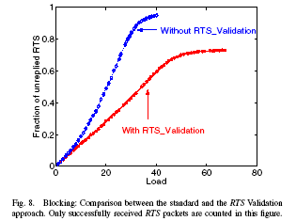
Simulation Results

Slide 26
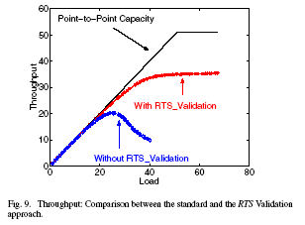
Simulation Results (continued)

Slide 27
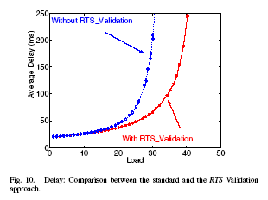
Simulation Results (continued)

Slide 28
Summary
RTS/CTS mechanism widely used in ad hoc networks to avoid collisions caused by hidden nodes, however, leads to false blocking
RTS Validation is a backward-compatible solution to solve false blocking, which could otherwise lead to pseudo-deadlocks due to propagation

Slide 29
Summary (continued)
A node that uses RTS Validation will defer only for a short time if no DATA transmission is expected
Simulation results show that RTS Validation improves network performance
  Elimination of MAC-level congestion by stabilizing throughput at high loads
  60% increase of peak throughput
  Significant reduction of average delay

Slide 30
Questions?
Simulation did not consider mobile nodes but attempted to randomize transmission using probability formulas
Thank You, I’m Out
Presentation by Fred Sangokoya

